Slide 1
HR ANALYTICS
- GROUP 5

Slide 2
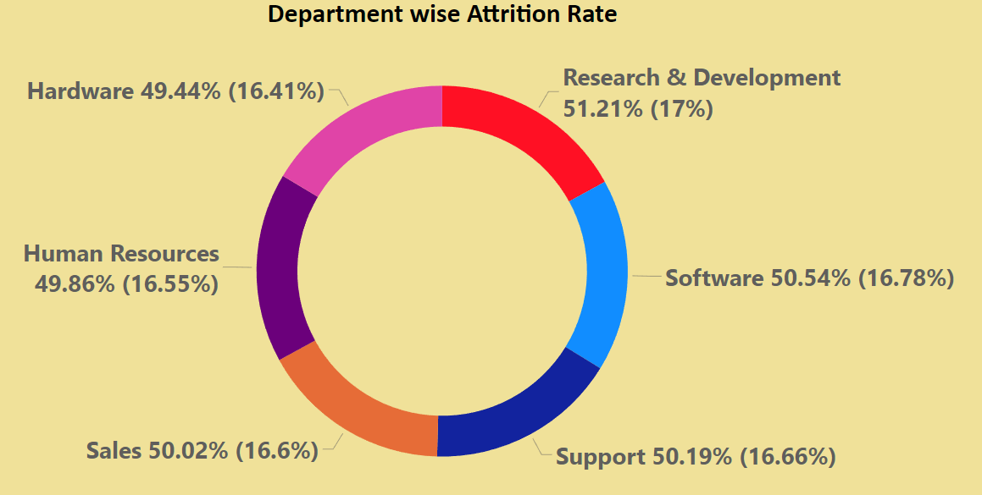
KPI 1
Attrition Rate by Department:
The KPI shows the Average of Attrition Rate by Department.
Research & Development department has the highest attrition rate at 51.21%.
Hardware has the lowest at 49.44%.

Slide 3
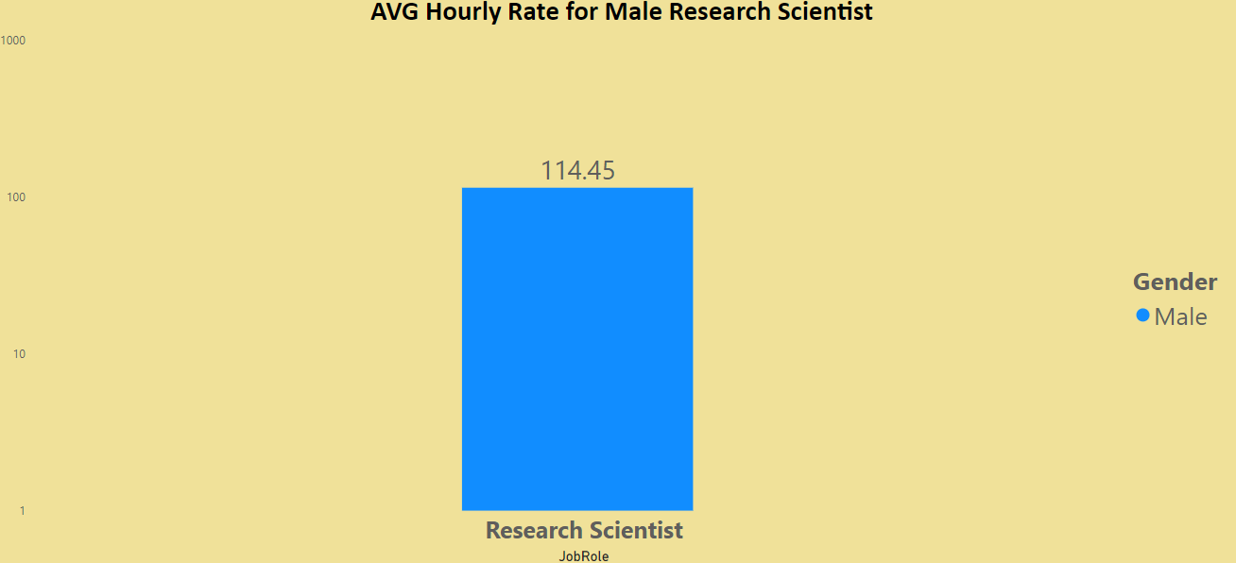
KPI 2
Average Hourly Rate for Male Research Scientist:
The KPI shows Average Hourly Rate for Male Research Scientist.
It shows that the average male research scientist earns around $114.45.

Slide 4
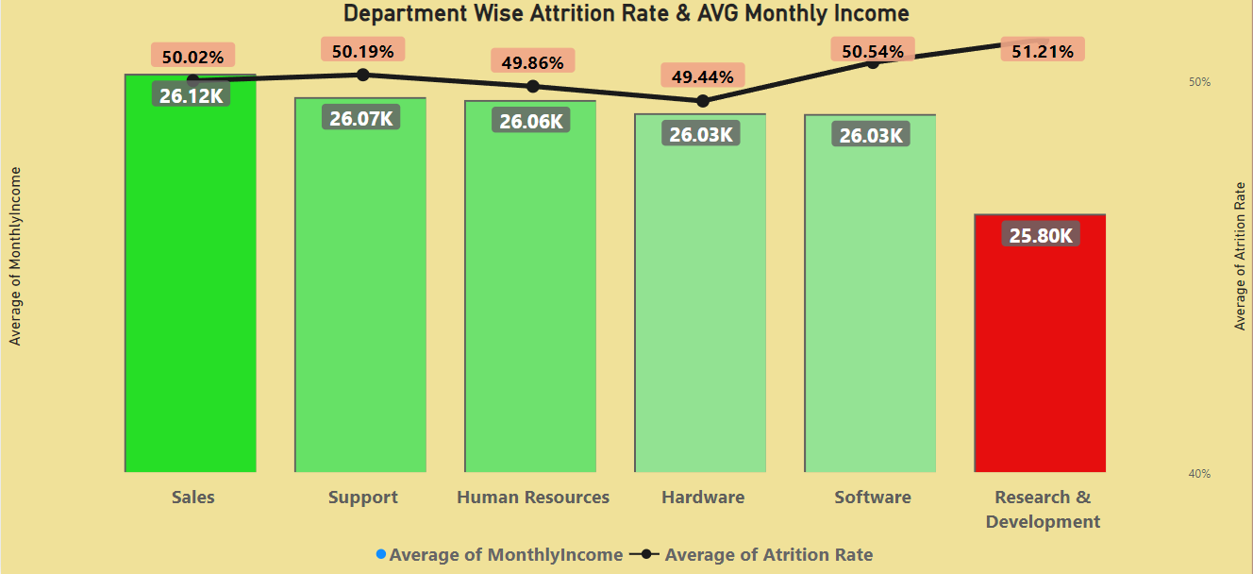
KPI 3
Average Monthly Income:
The Average Monthly Income varies across departments.
Sales has the highest average monthly income at $26,118.75.
Human Resources has the lowest at $25,796.08.
The relation between the average monthly income and the attrition rate can also be seen here.
It can be said that lower average monthly income can result in higher attrition rate of the company.

Slide 5
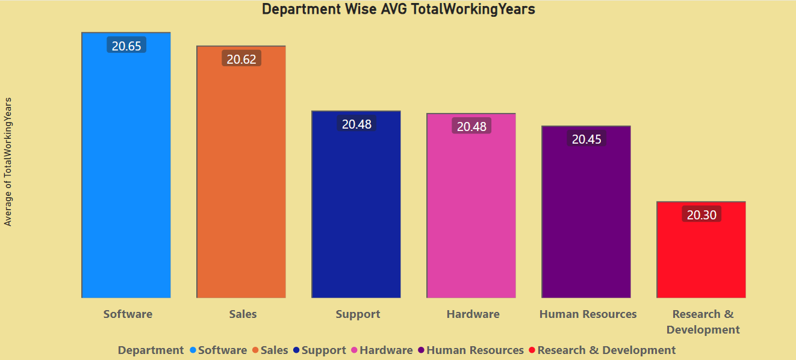
KPI 4
Average Working Years:
The highest average working years is for the Software Department of 20.65 years.
The lowest average working years is for the Research & Development Department of 20.30 years.

Slide 6
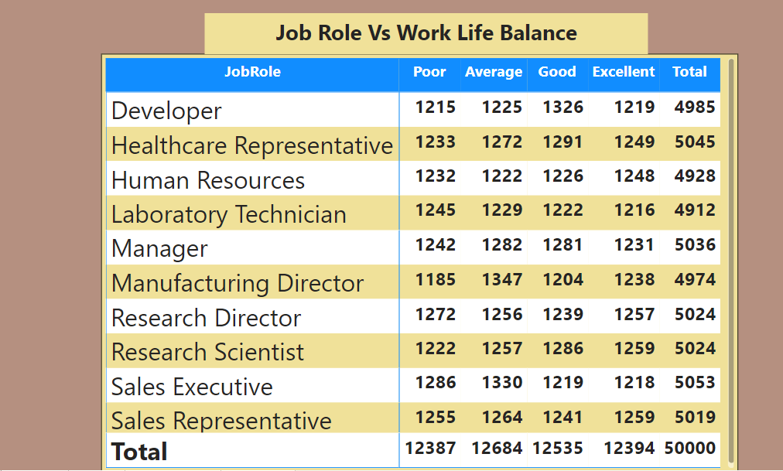
KPI 5
Job Role vs Work Life Balance:
The KPI shows Average Hourly Rate for Male Research Scientist.
In this dataset, every department present are almost equally satisfied and dissatisfied with their Job Role vs Work Life Balance.
However, the most votes for the Job Role vs Work Life Balance is Average.
The least votes for the Job Role vs Work Life Balance is Poor.

Slide 7
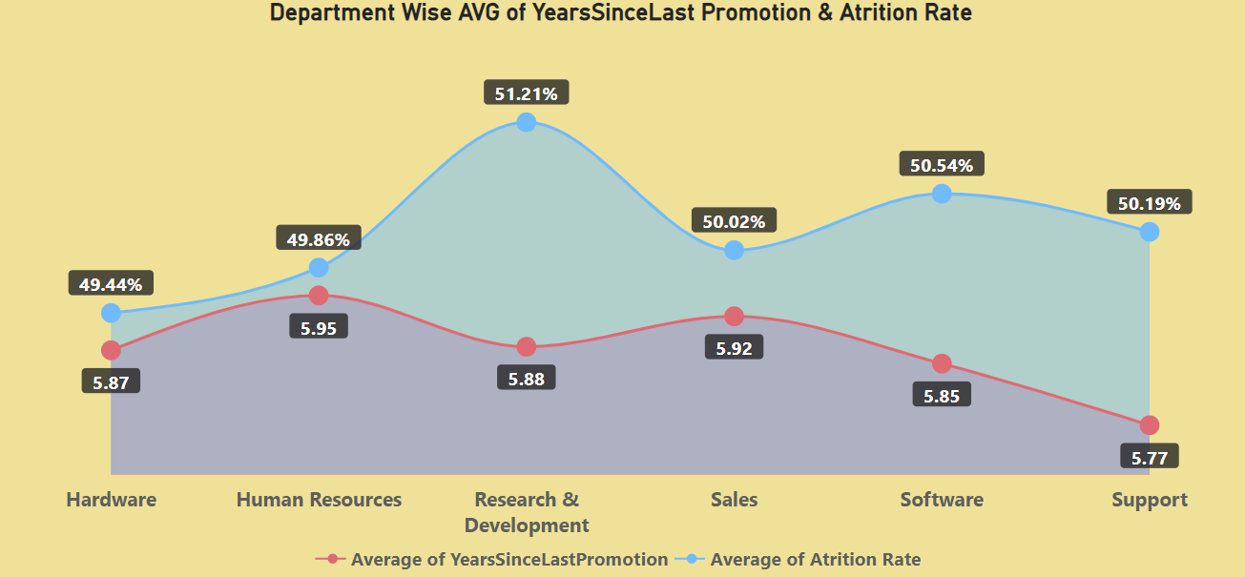
KPI 6
Attrition Rate vs Average of Year since last promotion:
The KPI shows the Attrition Rate vs Average of Year since last promotion.
The highest year since last promotion is for the Human Resources Department of 5.95 years.
The lowest year since last promotion is for the Support Department of 5.77 years.
The average of year since last promotion corresponds to the attrition rate where it varies by being very high to the Research & Development Department (51.21%) and the Hardware Department being low (49.44%).

Slide 8
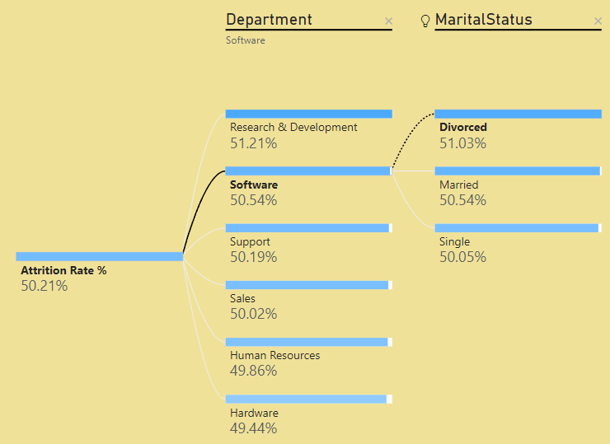
KPI 7
Marital Status of Department corresponding to Attrition Rate:
The KPI shows the Marital Status of each Department corresponding to their Attrition Rate.
It shows that the most people in the Research & Development are married which might be a reason for the higher Attrition Rate.

Slide 9
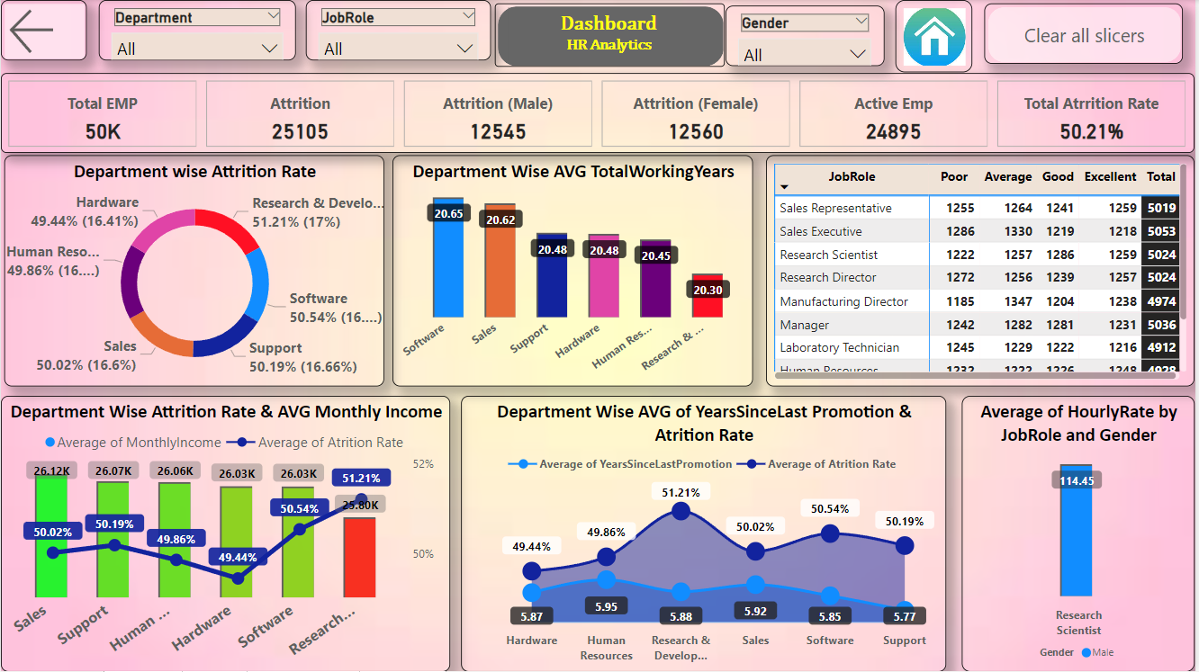
DASHBOARD – POWER BI
The dashboard shows us all the KPI’s integrated in a seamless way using the features of the Power Bi visualization tool.
Slicers have been added to drop-down and categorize the dashboard and the KPI’s present in it.
Page navigation is used to navigate along the file whenever necessary.
Overall, this dashboard provides us a great insight into the dataset and helps us to understand and visualize the data better.

Slide 10
Thank you

